Slide 1
Airline On-Time Analysis System
Overview
US Airline On-Time dataset, which consists of flight arrival and departure from 1987 to 2008
details are available at Harvard Dataverse Repository.
https://dataverse.harvard.edu/dataset.xhtml?persistentId=doi:10.7910/DVN/HG7NV7
With this project, we want to analyze this dataset and answer questions:
When is the best time of day/day of week/time of year to fly to minimum delays,
Do older planes suffer more delays?
How does the number of people flying between different locations change over time?
Datasets:
Main dataset | The main dataset contains flight date, origin, destination, delay. It includes 22 compress csv files, 120 million rows, 1.6 gb space compressed or 12 gb uncompressed.
Other datasets | It also contains 3 small data set “Airport”, “plane”, “carrier”, each with thousands rows.

Slide 2
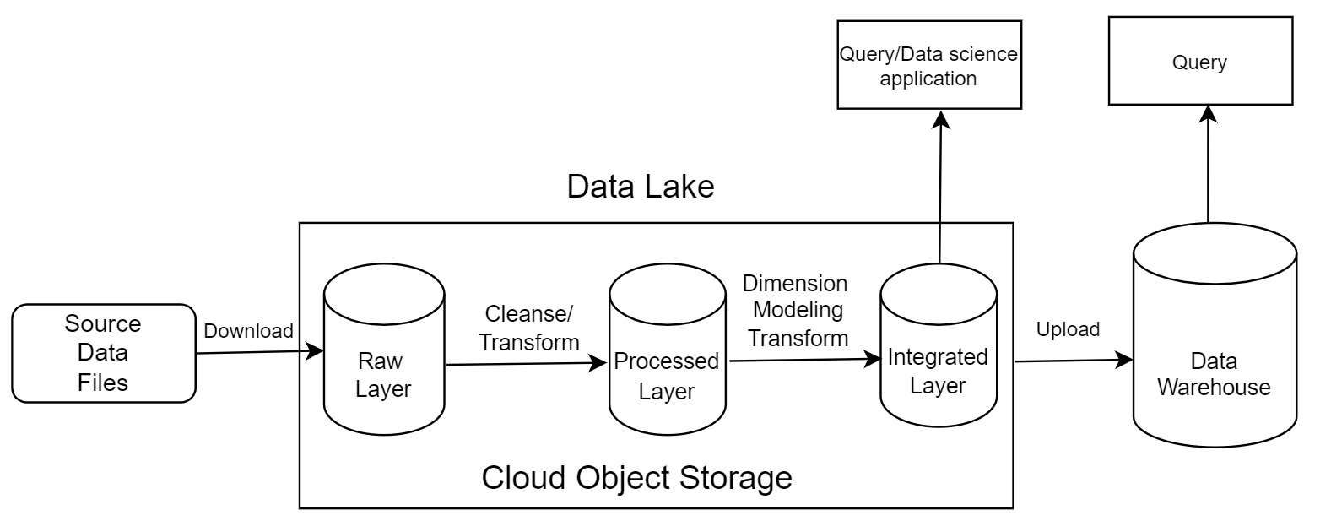
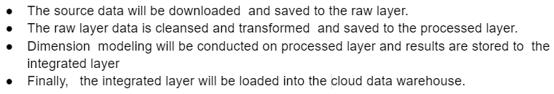
Architecture
Notes:
The data will be stored in 4 different layers (raw, processed, integrated, data warehouse), on cloud or in cloud data warehouse

Slide 3
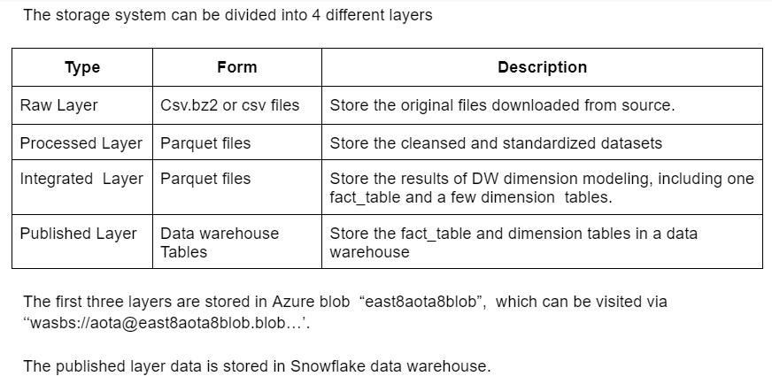
Storage

Slide 4
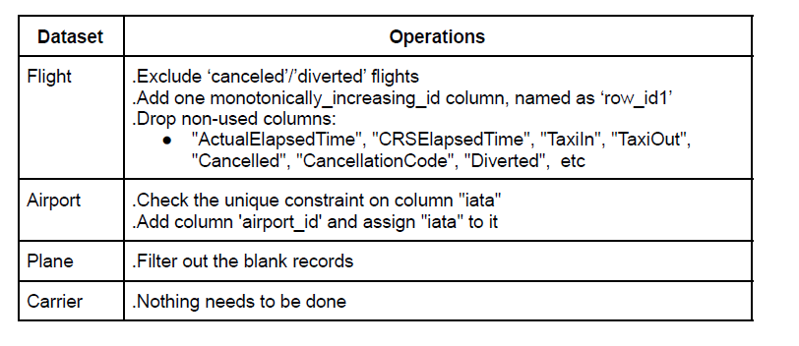
1. ETL process (Cleansing and transformation)
Main process
This process will cleanse and transform the raw data and store the results to the processed layer. Here is the logic:

Slide 5
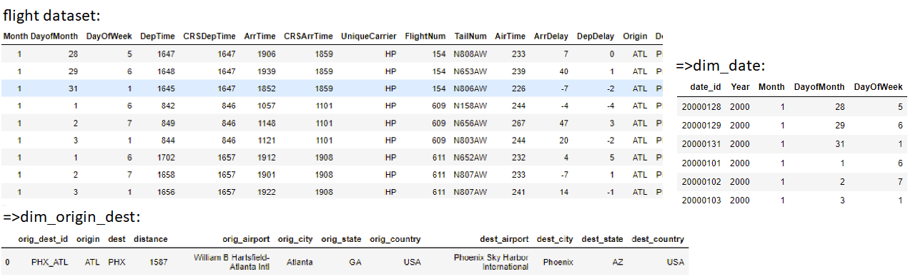
2. Integration (DW Dimension modeling) process
This process will create fact table and dimension tables. The core logic is to create fact table ‘fact_flight’, dimension tables ‘dim_date’ and ‘dim_origin_dest’, based on the flight data set.
In the following example, the 9 sample records from source dataset ‘flight’ will generate 9 ‘fact_flight’ records, 6 ‘dim_date’ records (as it contains 6 unique dates) and 1 ‘dim_origin_dest’ record (as it contains 1 unique origin-destination combination).
Notes:
This process will create fact table and dimension tables. The core logic is create table fac_flight, dim_date and dim_origin_dest based on the flight data set. In the following example, the 9 sample source flight records will create 9 fact_flight record, 6 dim_date records (as it contains 6 unique dates) and 1 dim_origin_dest record (as it contains 1 unique origin-destination combination).

Slide 6
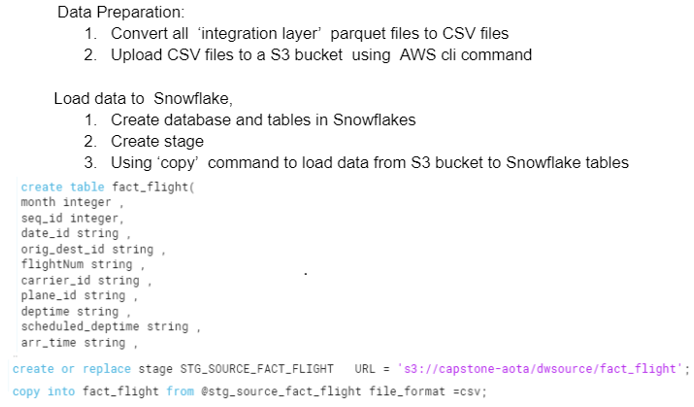
3. DW-ETL process: this process is to load data from the integrated layer to Snowflake data warehouse. Here are the steps:

Slide 7
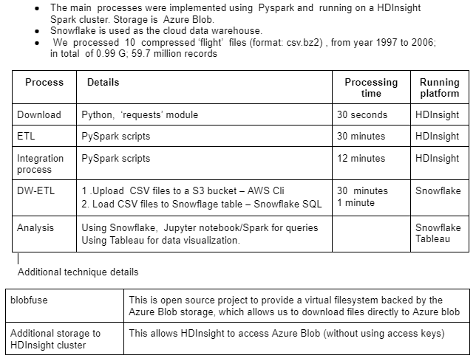
Implementation and run

Slide 8
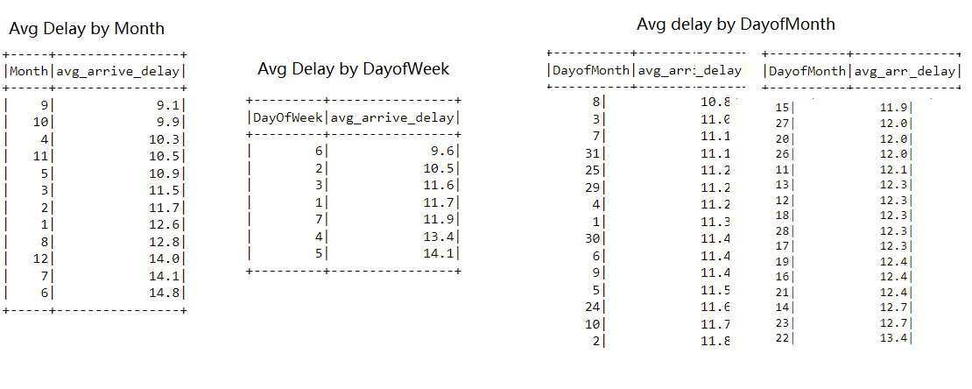
Question: When is the best time of day/day of week/time of year to fly to minimum delays?
Analysis: Finally, we ran queries using our published layer data (Snowflow tables) or integrated layer (parquet files) and got answers to our questions.
Answers: The best month is Sep; best day of week is Saturday; best day of month is 8th.

Slide 9
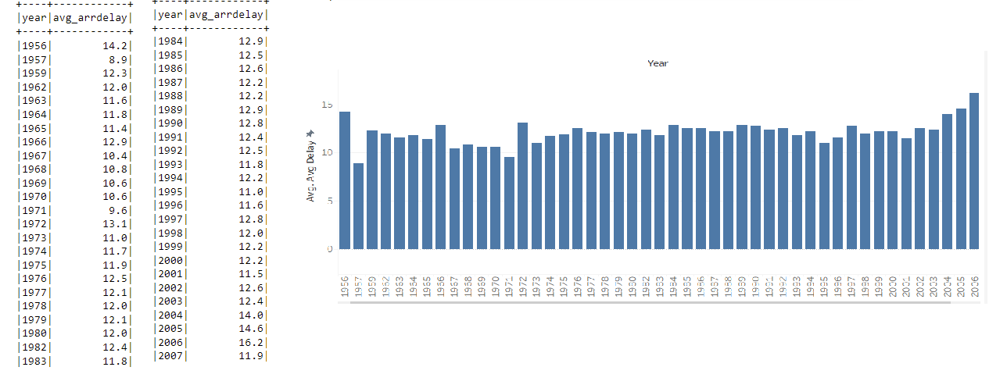
Question: Do older planes suffer more delays?
Answer: No

Slide 10
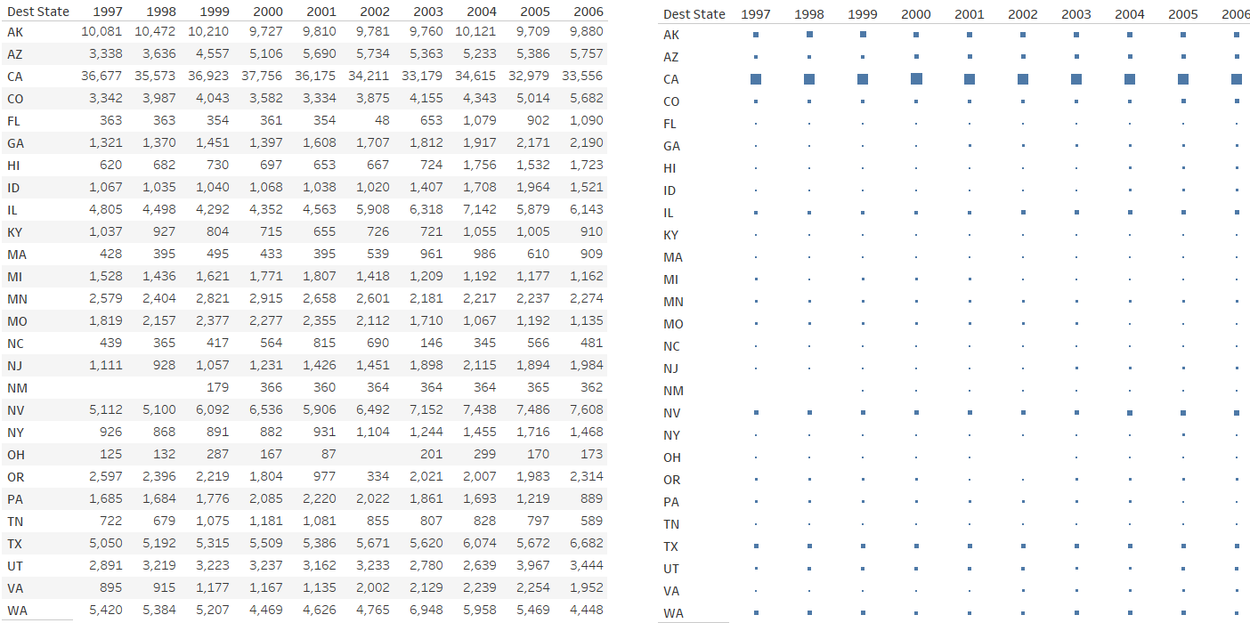
Changes on the number of flights departing from Seattle to different states between 1997 and 2006

